Slide 1

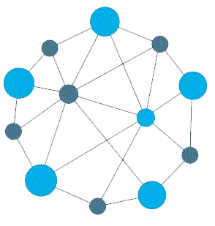

Slide 2
About today…
React.js
Props
Proptypes

Slide 3
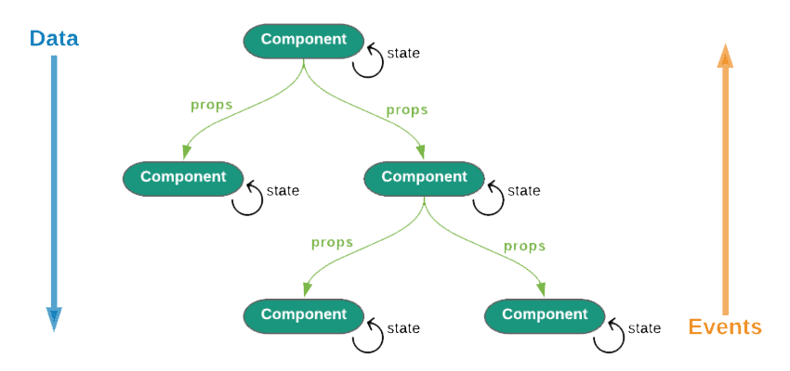
REACT PROPS
Objective
For efficient communication for dynamic content rendering in React

Slide 4
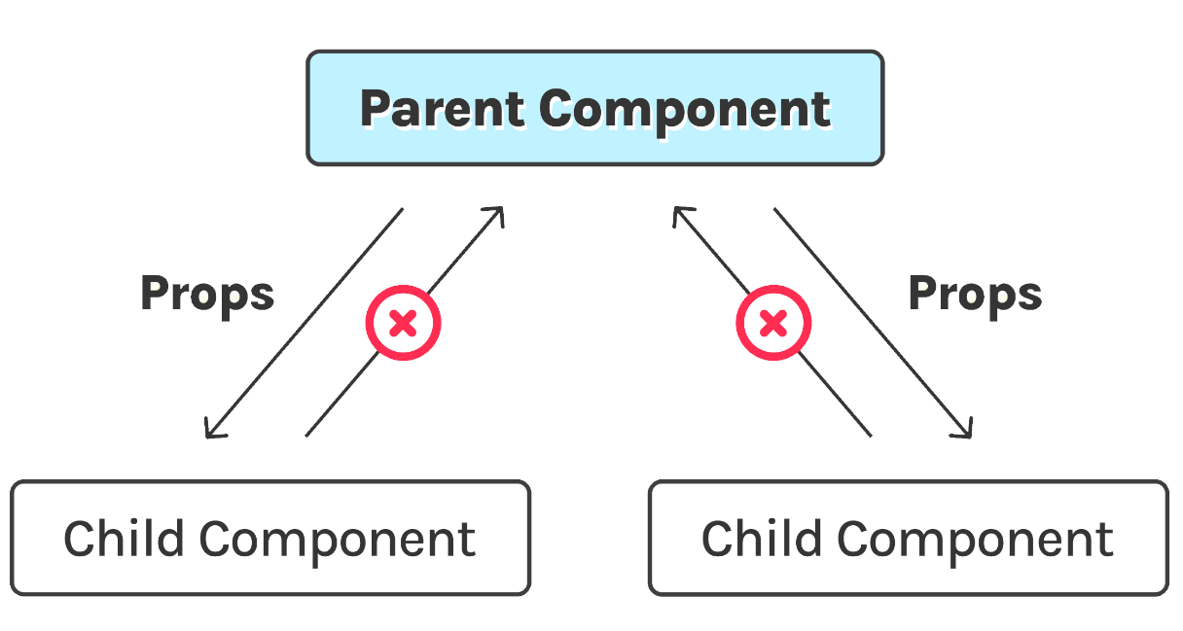
Introduction to React Props
Arguments passed into React components
Passed to components via HTML attributes
Allow to customize and configure child components
Read-only and cannot be modified by the child component

Slide 5

Declaring and Using Props
Props are declared as attributes in JSX
Passed to components like HTML attributes

Slide 6

Accessing Props
Accessed directly as parameters to the component function

Slide 7
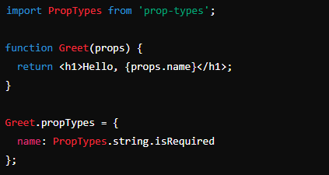
PropTypes for Type Checking
Used to validate the type of props passed to a component
Help catch bugs early by checking prop types during development
Supports various data types for type checking
string
number
bool
array
object
func
symbol
* name is required to be a string

Slide 8


Slide 9

What are React Props used for?
How do you access props in functional components?
What is the purpose of PropTypes in React?
Which PropTypes type is used to validate an array of strings?

Slide 10

Task
Create a simple React component that takes a name prop and displays a greeting message

